Slide 1
Introducere în Programarea Jocurilor pe Calculator
Cursul 2 bis

Slide 2
Input methods - Keyboard
GetKeyDown - true/false in functie daca tasta primita ca parametru a inceput sa fie apasata in acest frame.
GetKeyUp - true/false in functie daca tasta primita ca parametru a fost eliberata (nu se mai apasa pe ea) incepand din acest frame
GetKey - true/false in functie daca tasta primita ca parametru este apasata in acest moment (apasarea ar fi putut sa inceapa mai demult)

Slide 3
Input methods - Keyboard
if (Input.GetKeyDown(KeyCode.A))
{ Debug.Log("The A key was pressed!");}
if (Input.GetKey(KeyCode.A))
{ Debug.Log("The A key is being held down!");}
if (Input.GetKeyUp(KeyCode.A))
{ Debug.Log("The A key was released!");}
if (Input.anyKeyDown)
{ Debug.Log("A key was pressed!");}

Slide 4
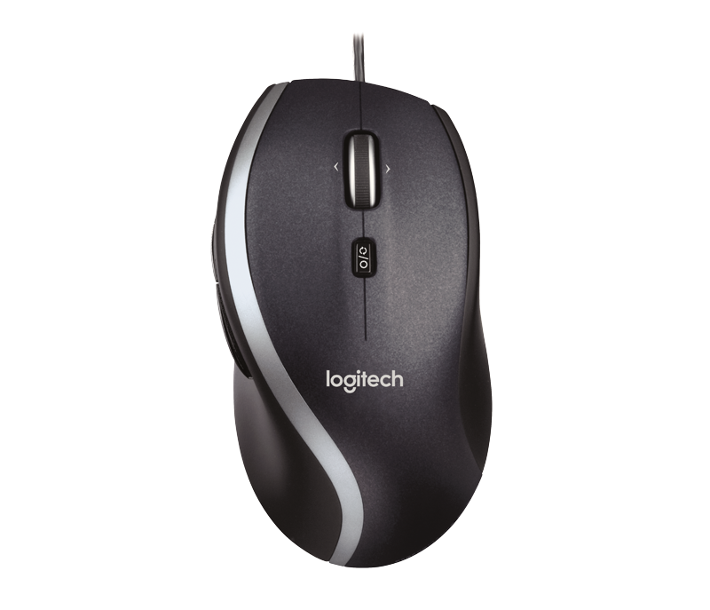
Input methods - Mouse Clicks
GetMouseButtonDown - true/false in functie daca butonul primit ca parametru (ex: 0,1,2) incepe sa fie apasasat in acest frame
GetMouseButtonUp - true/false in functie daca butonul primit ca parametru (ex: 0,1,2) incepe sa fie eliberat in acest frame
GetMouseButton - true/false in functie daca butonul primit ca parametru (ex: 0,1,2) este apasata in acest moment (apasarea ar fi putut sa inceapa mai demult)
2
0
1

Slide 5
Input methods - Mouse Clicks
if (Input.GetMouseButtonDown(0))
{ Debug.Log("Left mouse button was pressed!");}
if (Input.GetMouseButtonDown(1))
{ Debug.Log("Right mouse button was pressed!");}
if (Input.GetMouseButtonDown(2))
{ Debug.Log("Scroll wheel was pressed!");}
if (Input.GetMouseButton(0))
{
Debug.Log("Left mouse button is being held down!");
}
if (Input.GetMouseButtonUp(0)) {
Debug.Log("Left mouse button was released!");
}

Slide 6
Input methods - Mouse Motion
Input.GetAxis(“Mouse X”) - Returnează un un numar in intervalul [-1,0) pentru o miscare a cursorului catre stanga; un numar in intervalul (0,1] pentru o miscare a cursorului catre dreapta; 0 daca acesta ramane nemiscat
Input.GetAxis(“Mouse Y”) - analog pentru mișcare in jos/sus sau stationare

Slide 7
Input methods - Mouse Position
Input.mousePosition - Returnează un Vector3 (triplet) cu pozitia cursorului. Coltul din stanga jos avand coordonatele (0,0), iar cel din dreapta sus (RezX,RezY)
Camera.main.ScreenToViewportPoint(Input.mousePosition) - normalizeaza pe suprafața [(0,0) ; (1,1)]

Slide 8
Input methods -Gamepad
Observație: Pot exista pana la cel mult 8 gamepad-uri conectat la un moment dat. Fiecare gamepad are până la 20 de butoane, mapate în funcție de producător.
Input.GetJoystickNames() - retunează un vector de stringuri reprezentând numele fiecărui pad.
Odată aflat numele, putem accesa butoanele și joystick-ul folosind metodele de tip GetKey() sau GetAxis() - pentru care insa trebuie sa definim o mapare.
Ex: if(Input.GetKeyDown(KeyCode.Joystick1Button0))
Debug.Log(”Button was pressed”);

Slide 9
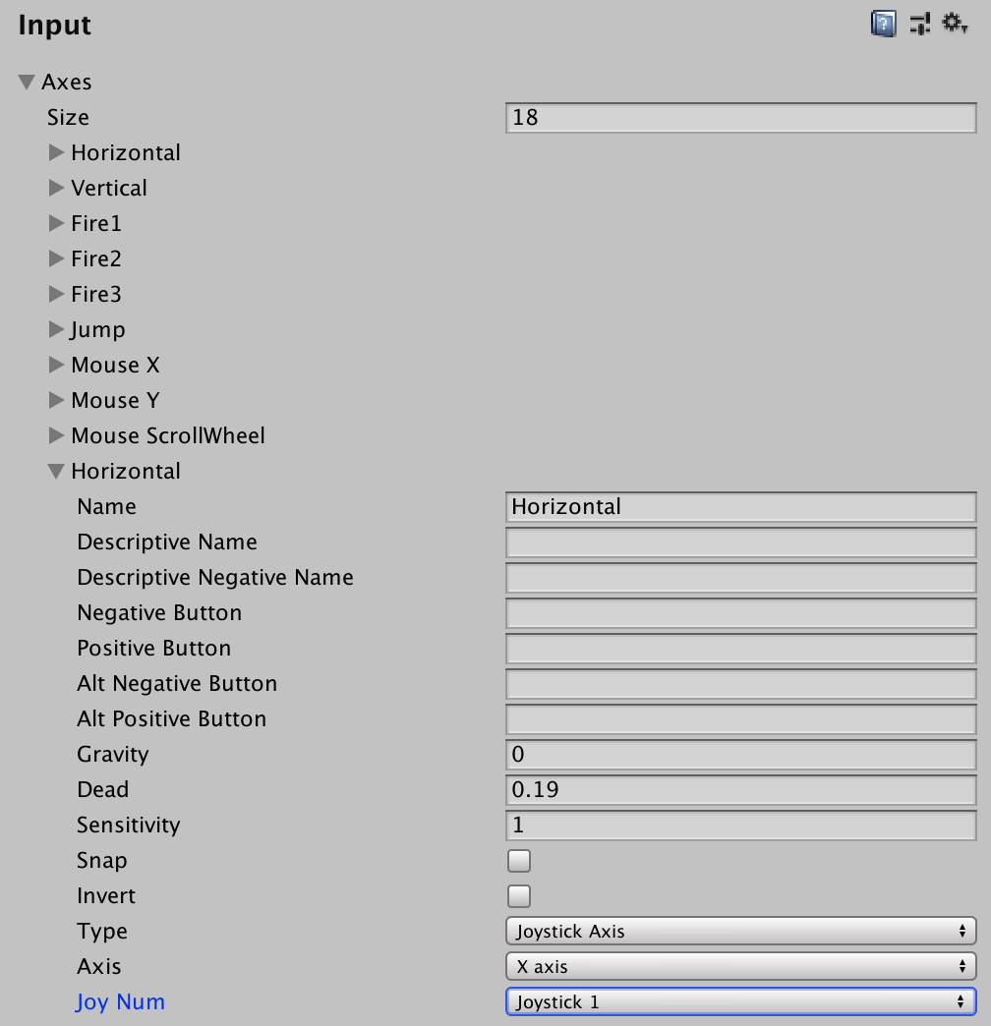
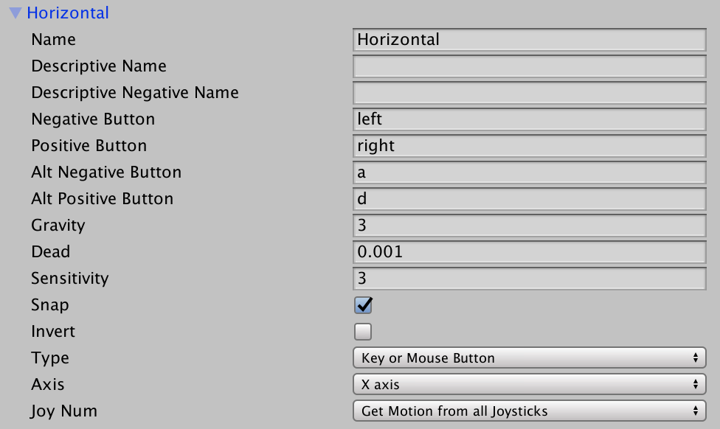
Custom Input
Edit>Settings>Input

Slide 10
Custom Input
Name
Enter the string that refers to the axis in the game launcher and through scripting.
Descriptive Name
Enter a detailed definition of the Positive Button function that appears in the game launcher.
Descriptive Negative Name
Enter a detailed definition of the Negative Button function that appears in the game launcher.
Negative Button
Enter the name of the button that sends a negative value to the axis.
source: https://docs.unity3d.com/Manual/class-InputManager.html

Slide 11
Custom Input
Positive Button
Enter the name of the button that sends a positive value to the axis.
Alt Negative Button
Enter the name of the secondary button that sends a negative value to the axis.
Alt Positive Button
Enter the name of the secondary button that sends a positive value to the axis.
Gravity
Set how fast the input re-centers. This property applies only when the Type is key / mouse button.

Slide 12
Custom Input
Dead
Any positive or negative values that are less than this number register as zero. Useful for joysticks.
Sensitivity
For keyboard input, a larger value results in faster response time. A lower value is smoother. For the mouse delta, this value scales the actual mouse delta.
Snap
Enable this option to immediately reset the axis value to zero after it receives opposite inputs. This property applies only when the Type is key / mouse button.
Invert
Enable this option to make the positive buttons send negative values to the axis, and vice versa.

Slide 13
Custom Input
Type
Choose what kind of input this axis can expect.
Key / Mouse Button Any kind of button. Mouse Movement Mouse delta and scrollwheels, etc
Axis
Choose the axis of input from the device (joystick, mouse, gamepad, etc.). Defaults to the X-axis.
Joy Num
Choose which joystick should be used. Defaults to retrieving the input from all joysticks.
Note: This is only used for input axes and not buttons.

Slide 14
Custom Input
De citit capitolul 3 din https://drive.google.com/open?id=1HXqyybCi4KKQEvRbwQqgI-d86kOYTa7M

